Slide 1
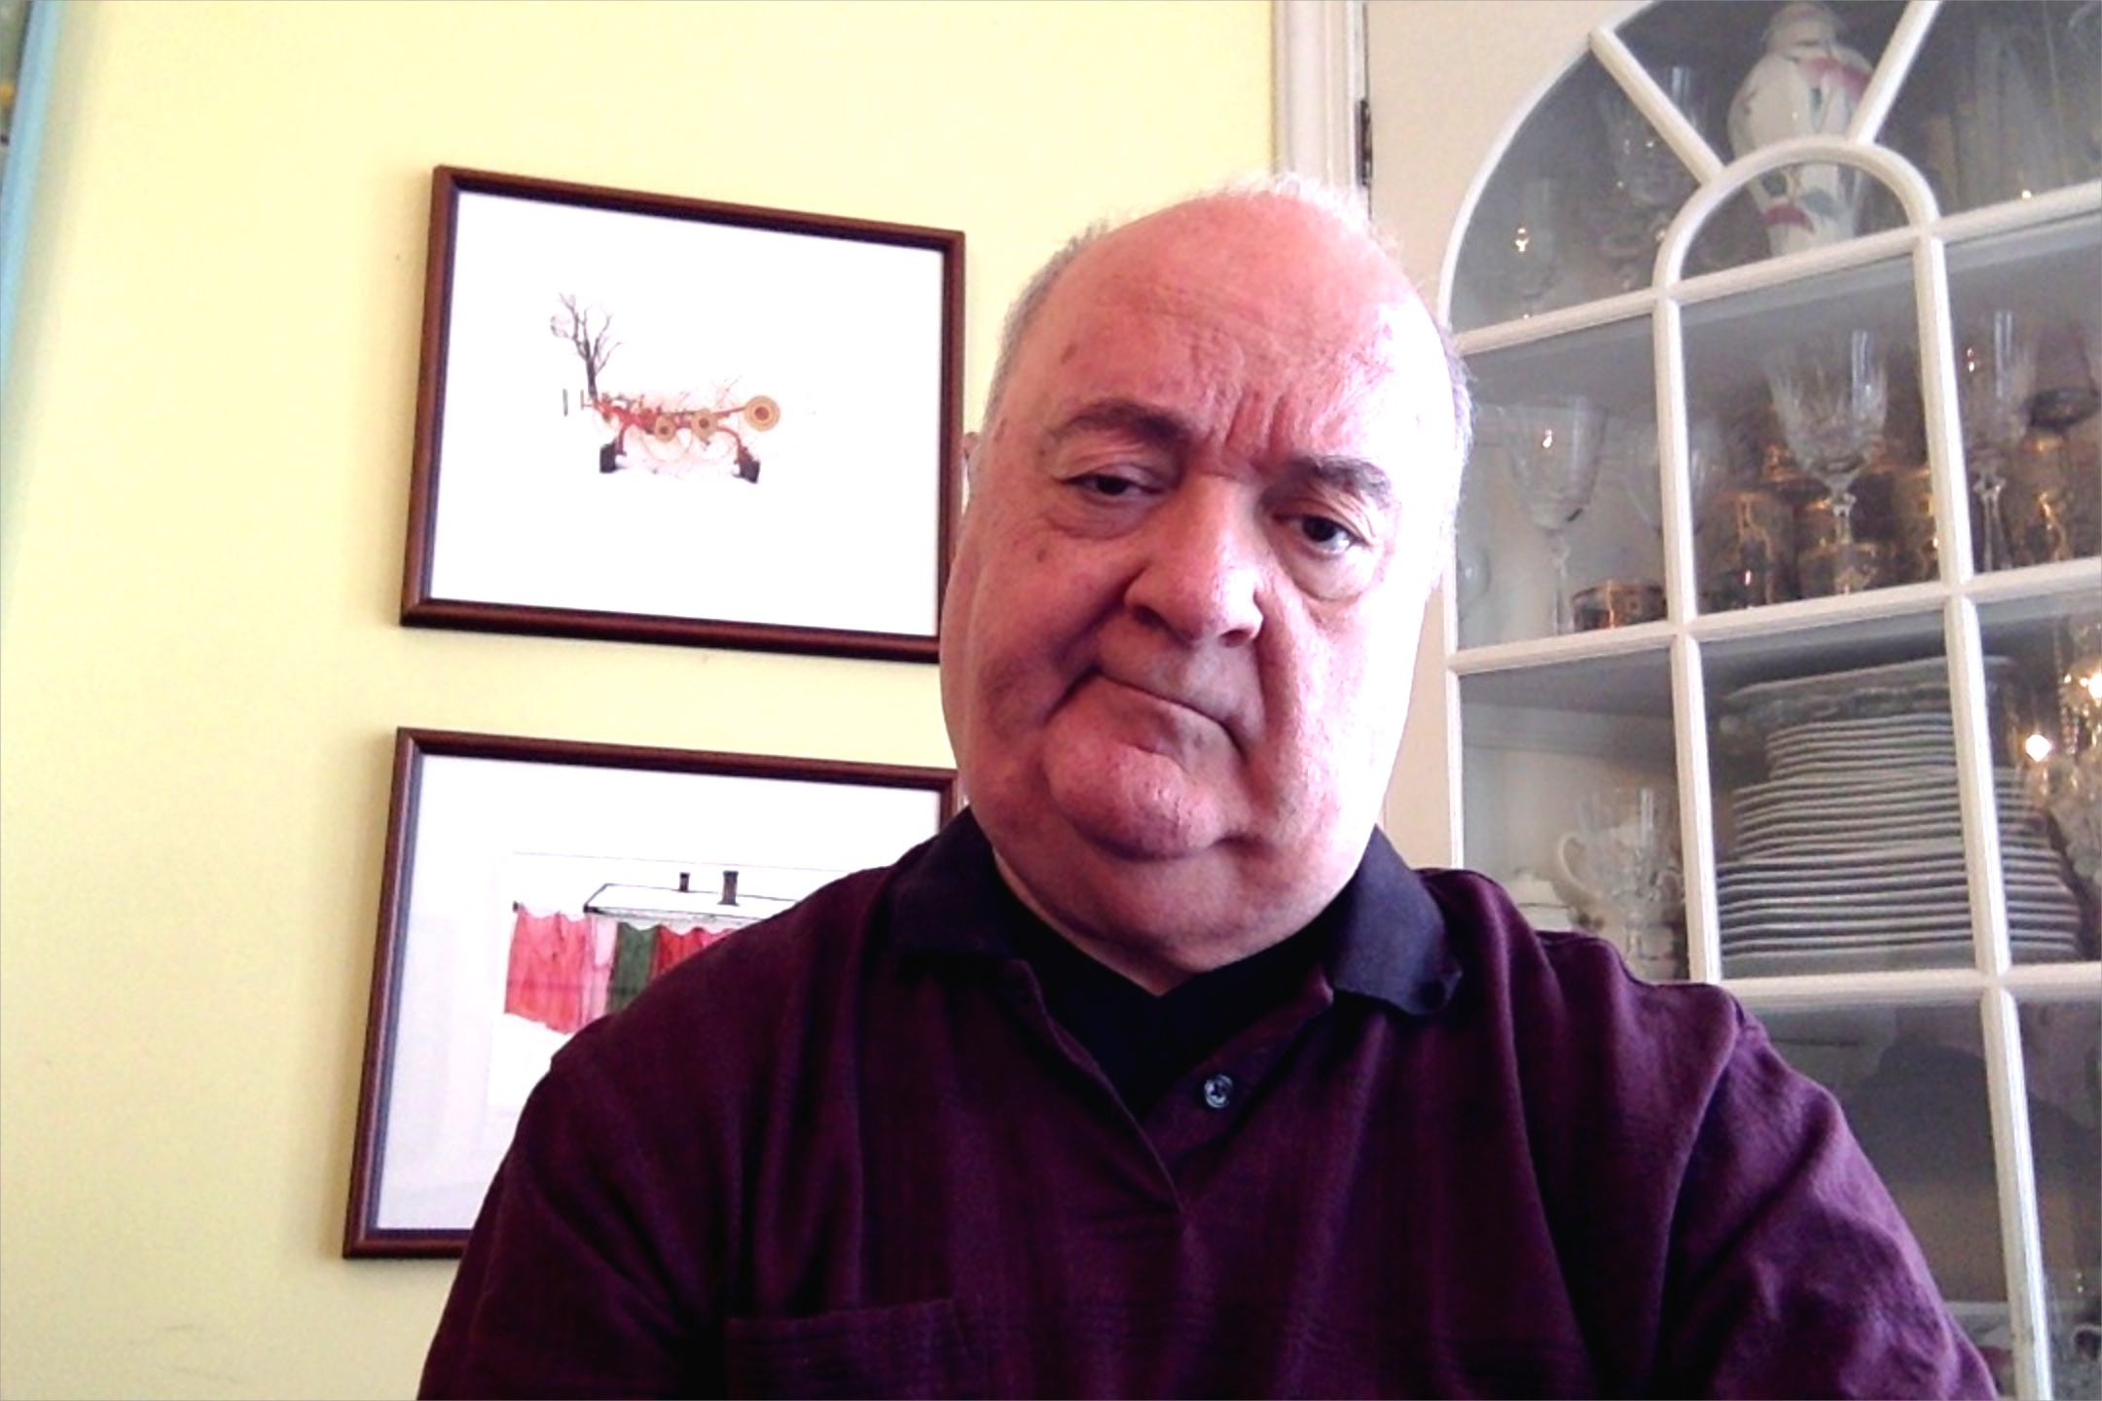
What do PM’s Think and Do? – leading to success / failure!
Left – Staring at this slide as I compose it, at my other home, in Dayton, OH, I become a part of the checkerboard pattern! Pictures behind me are scenes from Amish life in Holmes County, OH. My wife and I just visited. It snowed.
CSSE579
Week 1, Slide set 2

Slide 2
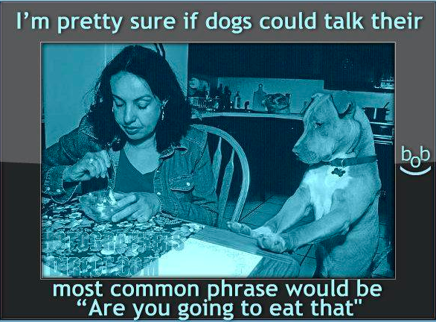
What is the dog thinking?
wondering –
?
Notes:
Engineers use architectures to get things right before implementation or even detailed design…

Slide 3
Management for Classical & Agile Projects
Planning
Directing
What PM’s are expected to do!
Software
Project
Staffing
Organizing
Controlling
Notes:
(23 min) We will look at these a bit closer tomorrow…

Slide 4
Planning
Predetermining a course of action for accomplishing organizational objectives.
  Set goals and objectives
  Develop strategies
  Determine courses of action
  Make decisions
  Set procedures & rules
  Develop programs
  Forecast future situations
  Prepare budgets
  Document project plans
Planning
Software
Project
Notes:
The purpose, goals, and objectives provide targets for a software project. While goals are an end state, objectives provide measureable ways of seeing if the goal is being met.
Q6: What planning activity determines the targets for the project effort? [Setting goals and objectives]

Slide 5
Directing
Creating an atmosphere that will assist and motivate people to achieve desired results.
  Provide leadership
  Supervise personnel
  Delegate authority
  Motivate personnel
  Coordinate activities
  Facilitate communications
  Resolve conflicts
  Manage changes
  Document directing decisions
Directing
Software
Project
Notes:
Q: Which of the management activities provides for the requisite project leadership? [Directing]

Slide 6
Organizing
Arranging and relating work for accomplishment of objectives and the granting of responsibility and authority to obtain those objectives.
  Identify and group
  required tasks
  Select and establish
  organizational structures
  Create organizational positions
  Define responsibilities and authority
  Establish position qualifications
  Document organizational structures
Software
Project
Organizing

Slide 7
Controlling
Measuring and correcting performance of activities toward objectives according to plan.
  Develop standards of performance
  Establish monitoring and reporting
  systems
  Measure results
  Initiate corrective actions
  Reward and discipline
  Document controlling methods
Software
Project
Controlling

Slide 8
Staffing
Selecting and training people for positions in the organization.
  Fill organizational positions
  Assimilate newly assigned personnel
  Educate or train personnel
  Provide for general development
  Evaluate and appraise
  personnel
  Compensate
  Terminate assignments
  Document staffing decisions
Software
Project
Staffing

Slide 9
Separate? but Dependent Functions
Directing
according
to Plan
Planning for
Organizing
Planning
Directing
Software
Project
Organizing for
Planning Activity
Staffing for Planning
Organization
Staffing
Organizing
Controlling
Controlling the
Planning Activities

Slide 10
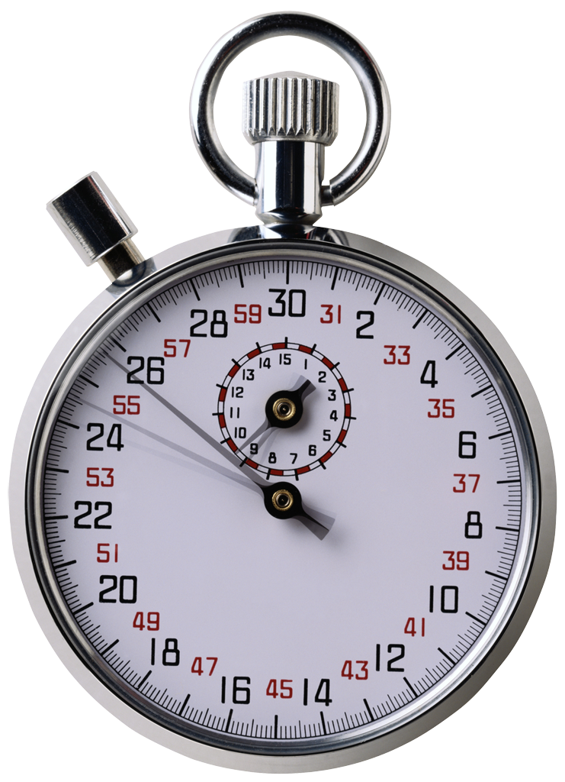
How can Software Project Management be done badly?
Same teams as for the “bears.”
  Observers: Describe the process used.
Come up with one really bad way to do things, for each team member!
On your team, discuss what problems that would cause.
As a team – pick the worst one.
The originator of that idea – report this one to the class.
5 minutes?
Notes:
People get injured or worst
Money loss
Time loss

Slide 11
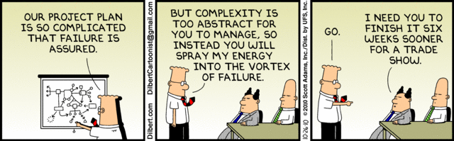
Dilbert’s take on Project Failure…
Notes:
Image from http://www.colindellis.com/pmo-killing-projectmanagement/

Slide 12

Epic Software Failures
European Space Agency’s Ariane 5 Explosion
Hospital Radiation Incident
London Ambulance Service
East Coast Blackout
(cascading power plant failures)
AT&T Switch Failure -$Billion bug
NASA Mars Lander, Pathfinder,
and Spirit…
FAA’s Advanced Automation System (Homework target…)
http://www.cs.tau.ac.il/~nachumd/horror.html
Notes:
Q Please name three Epic / Infamous Software Failures.
[European Space Agency’s Ariane 5 Explosion
Hospital Radiation Incident
London Ambulance Service
Denver Airport Baggage Handler
East Coast Blackout
(cascading power plant failures)
AT&T Switch Failure -$Billion bug
FAA’s Advanced Automation System
NASA Mars Lander]

Slide 13
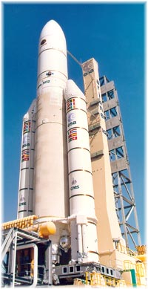
European Space Agency
Ariane 5 Failure
Ariane 4 SRI (Inertial Reference Systems)
software reused on new Ariane 5
Operand Error exception due overflow
in converting 64bit FP to 16bit INT
Launcher disintegrated after 39 sec
because of high aerodynamic loads
Cause: Unknown Reuse Risk in Business Case
Notes:
Q: What was the technical cause of the Ariane 5 explosion and the management cause? [Technical: Operand Error due to 64bit to 16bit conversion. Business: Unknown Reuse Risk]
Ariane 4 accelerated much slower, used different trajectory
On Board Computer interpreted SRI diagnostic pattern as flight data and commanded nozzle deflection
SRIs measuring the attitude and movements of the launcher.
Horizontal attitude sensor caused overflow.

Slide 14
Medical Radiation Incident
Machine provide graphical user interface
Hospital workers selected options via fields
  Tab-key & Shift-Tab combination used to move between fields
Some hospital workers used up & down arrows to move between rows of fields
  Moved cursor, but internally, didn’t change fields
Result: Data entered in wrong fields some patients over-radiated and did not survive

Slide 15
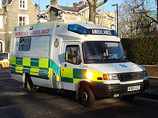
London Ambulance Service
Computer Aided Dispatch System to automate human-intensive processes of manual dispatch
  Call Taking (assumed to be better)
    Receive calls, record incident details, pinpoint location
System went live on 26th October 1992
  Taken offline next day and reverted to semi-manual dispatching on 28th October 1992
Increased incident errors =>increased number of exceptions =>increased incorrect information
Result: 20–30 people speculated to have died as a result of ambulances arriving too late
Notes:
Computer Aided Dispatch System to automate human-intensive processes of manual dispatch
Call Taking (assumed to be better) - Receive calls, record incident details, pinpoint location
System went live on 26th October 1992
Taken offline next day and reverted to semi-manual dispatching on 28th October 1992
Increased incident errors =>increased number of exceptions =>increased incorrect information
Multiple ambulances sent to same location
Closest ambulance not chosen for dispatch

Slide 16
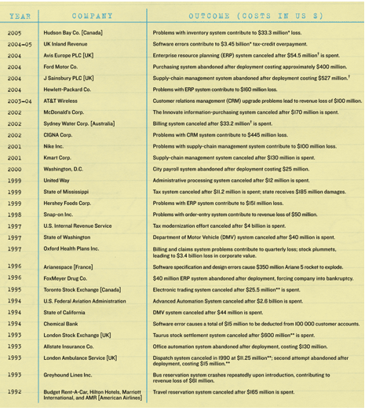
Software Project Wall of Shame… 1/2

Slide 17
Software Project Wall of Shame… 2/2

Slide 18
Why do Software Projects Fail?
1. Unrealistic or unarticulated project goals
2. Inaccurate estimates of needed resources
3. Badly defined system requirements
4. Poor reporting of the project's status
5. Unmanaged risks
6. Poor communication: clients, developers, & users
7. Use of immature technology
8. Inability to handle the project's complexity
9. Sloppy development practices
10. Poor project management
11. Stakeholder politics
12. Commercial pressures
Notes:
Q: What are the top two reasons software projects fail? [1.Unrealistic or unarticulated project goals 2. Inaccurate estimates of needed resources ]

Slide 19
5 Common Software Project Pitfalls – were any of these on your team’s list?
Beginning the programming before understanding the problem
Project team has unrealistic idea about how much work is involved
Defects injected early, but discovered late
Poor programming habits and no accountability for work
Managers trying to test quality into the software
Let’s take a look at these…

Slide 20
Beginning the Programming Before Understanding the Problem
Feel like they’re making progress
  Immediate gains may be artificial
Work gets bogged down with problems domain complexities
  Premature decisions remove alternative designs that may be
  more effective
May end up writing good software that solves the wrong problem
Notes:
Everyone likes to feel that they’re making progress
When the team starts to code as soon as the project begins, they see immediate gains
When problems become more complex (as they always do!), the work gets bogged down
In the best case, a team that begins programming too soon will end up writing good software that solves the wrong problem

Slide 21
Example
Each part looks like it should be doable…
1/4” I. D.
Cast Iron
1/4” I. D.
90-Degree
Cast Iron
Elbow (2)
Pipe (4)
4” typ
1/4” I. D.
Cast Iron
T-Fitting (2)
All Parts to be Standard, U. S.
1/4” Right-Hand Pipe Thread

Slide 22
Project Team has Unrealistic Idea About How Much Work is Involved
Complex problems often seem simple before they are attempted
Optimistic/Impossible deadlines result from not thinking through the work
Typical scenario:
  Very successful team
  New project looks just slightly harder / different
Notes:
Q: Why do project teams often have unrealistic perceptions about the amount of work involved in a project? [From far away, most complex problems seem simple to solve]
From far away, most complex problems seem simple to solve
Teams can commit to impossible deadlines by being overly optimistic and not thinking through the work
Few people realize the deadline is optimistic until it’s blown

Slide 23
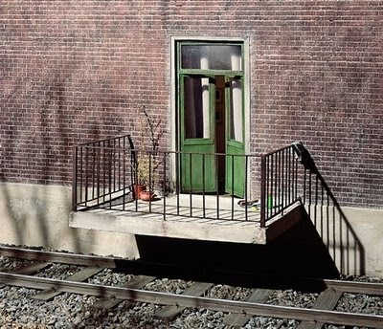
Defects Injected Early, but
Discovered Late
Address wrong needs
Specify incorrect behavior
Technically flawed Design
and Implementation
Test plans miss
functionality
The later these problems are found, the more likely they are to cause the project to fail
Notes:
Q: The later the problems are found in the ____________, the more likely they are to cause the ________ to fail. [life cycle, project]
Projects can address the wrong needs
Requirements can specify incorrect behavior
Design, architecture and code can be technically flawed
Test plans can miss functionality
The later these problems are found, the more likely they are to cause the project to fail

Slide 24
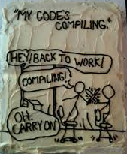
Poor Programming Habits and
No Accountability for Work
Poor control of source code
and other artifacts
Write-Only Code
Poor test cases
The team does not have a good sense of the overall health of the project
Notes:
Programmers don’t have good control of their source code
Code written by one person is often difficult for another person to understand
Programmers don’t test their code, which makes diagnosing and fixing bugs more expensive
The team does not have a good sense of the overall health of the project.

Slide 25

Managers trying to test quality into the software
Assumes testers will catch all of the defects
When testers miss defects, everyone blames them for not being perfect
Notes:
Everyone assumes that the testers will catch all of the defects that were injected throughout the project.
When testers look for defects, managers tell them they are wasting time.
When testers find defects, programmers are antagonized because they feel that they are being personally criticized.
When testers miss defects, everyone blames them for not being perfect.

Slide 26
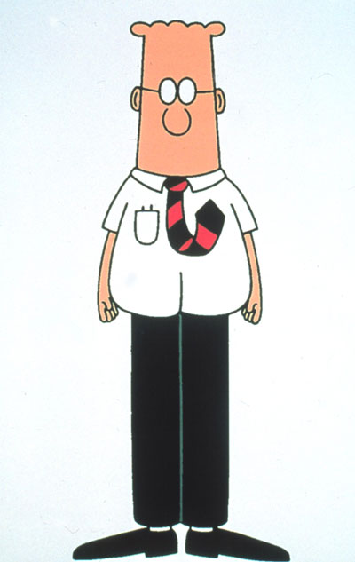
So, what would our friend Dilbert do in the face of a failing software project?
… errr, after his in-depth discussion with his friends ☺

Slide 27
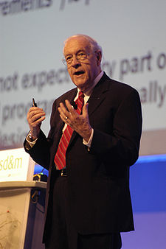
State of the Art vs. State of the Practice
“The gap between the best software engineering practice and the average practice is very wide–perhaps wider than in any other engineering discipline.”
– Fred Brooks
Notes:
The fact that good techniques aren’t being commonly used doesn’t mean they don’t exist.

Slide 28
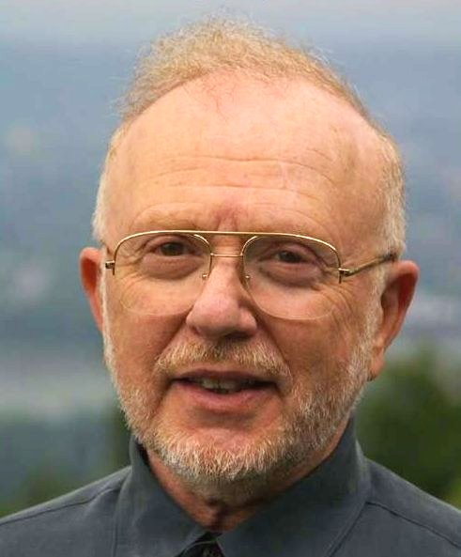
What are Some Keys to Success?
Question: What are the most exciting/promising software engineering ideas or techniques on the horizon?
Answer: I don’t think that the most promising ideas are on the horizon. They are already here and have been here for years
but are not being used properly.
— David L. Parnas

Slide 29
What’s Parnas Talking About?
Project planning and management practices
  Automated estimation tools (1973)
  Evolutionary delivery (1988)
  Measurement (1977)
  Productivity environments (1984)
  Risk management planning (1981)
Requirements engineering practices
  Change board (1979)
  Throwaway user interface prototyping (1975)
  JAD sessions (1985)
  Requirements scrubbing (1989)
Notes:
This is where CSSE 371 and 372 kind of come together…
Sriram looks at RE practices to address the problem while we look at PM practices
They are both necessary to be a competent software engineer!

Slide 30

How can software projects succeed?
Make sure all decisions are based on openly shared information
Don’t second-guess your team members’ expertise
Introduce software quality from the very beginning of the project
Notes:
Q: Making sure all decisions are based on openly shared information engenders important factor in a successful team? [trust]
Culture of transparency, where everyone who needs information knows where to find it and is comfortable looking at it.
All project documents shared with the entire team, managers, stakeholders, users ...
Managers need to trust team members. If you don’t have a good reason to veto an idea, don’t.
Review everything, test everything. Use reviews to find defects – but don’t expect the review to be perfect.
Use reviews to gain a real commitment from the team.

Slide 31

How can software projects succeed?
Don’t impose an artificial hierarchy on the project team
Remember that the fastest way through the project is to use good engineering practices
Notes:
Q: Shortening/Reducing important tasks like estimation, reviews, requirements gathering and testing expose a project to what? [higher costs, time, and lower quality products]
All software engineers were created equal -- not really, but socially.
A manager should not assume that programming is more difficult or technical than design, testing or requirements engineering.
Managers and teams often want to cut important tasks – especially estimation, reviews, requirements gathering and testing.
If it were faster to build the software without these practices, we would never use them. Cutting them out will cost time and reduce quality.

Slide 32

Anatomy of a Project
A Customer/Client
Their Representatives
Goal-Oriented Plan
Practices and Processes
Project Team
Larger Organization
Resources
Commitment
Notes:
Q: What are six key elements of a project?
A Customer/Client
Goal-Oriented Plan
Tasks, deliverables, milestones, resources, estimates, risks, control mechanisms, roles/responsibilities, schedule, rationale/assumptions…
Practices and Processes
Standard practices, defined processes
A mechanism to select and tailor them
Project Team
Roles and responsibilities
Skills, experience, compatibility, …
Resources
Time, people, facilities
Commitment
Management and customer

Slide 33
Stakeholders and Their Concerns
Maintainer
Functionality
Price
End User
Dev Costs
On Time Delivery
Client/Customer
Performance
Program Manager
“Sales”/Contracting
Stability & Maintainability
“Engineering”
Ease of Integration
Ease of Use
Dev Manager
Related Engg Groups
Ease of Debugging
Project Manager
Modifiability
Software / Tech Lead
Testability & Traceability
Developer/Engr
QA/Tester
Structure & dependency between component
Sys Admin
Ease of Installation
Installer

Slide 34
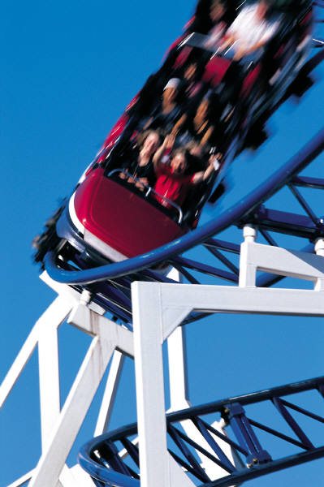
Stakeholders and Clients
Relationship
Engagement
Value proposition
Buy in
Stakeholders may have an interest, influence, or investment, but typically convey buy-in
A client is a stakeholder with the authority to make commitments and decisions regarding the product to be delivered
Why is a project without a client is already in trouble?
Notes:
Q: What is the difference between a stakeholder and a client? A client is a stakeholder with fiduciary influence or responsibility for the project.
Customers can sometimes make monkeys out of project managers… video next slide…
Relationship -- Trust relationship is good – latitude to work in the customer’s interests
Engagement -- Distance is not good
Messages through and intermediary is a bad sign
Contracts can hamper understanding
Value proposition -- What do they value and how much can you align with that without compromising profits
Buy in

Slide 35
Essence of a Project Plan
Why is the system being developed? (Goal)
What will be done? By when? (Goals)
Who is responsible for a function or component?
Where are they organizationally located?
How will the job be done technically and managerially?
How much of each resource (e.g., people, software, tools, database) will be needed?

Slide 36
Project Classification
PROJECT CLASS
COMP-
LEXITY
TECH-
NOLOGY
LIKELIHOOD OF PROBLEMS
DURATION
RISK
Type A
> 18 months
High
High
Break-
through
Certain
Type B
9-18 months
Medium
Medium
Current
Likely
Type C
3-9 months
Low
Low
Best of
Breed
Unlikely
Type D
<3 months
Very
Low
Very Low
Practical
None
Bottom Line: 1 size does not fit all!
Notes:
36
Risk
Business Value
Duration
Complexity
Technology used
Impact of project (e.g., # of depts affected)
Cost
Source: Robert Wysocki EPM Text

Slide 37

Software Projects can get Creepy
Scope Creep
Attitude Creep
  Hope -> Despair
Effort Creep
  40 hrs -> 80 hrs per week
Feature Creep
  Gold plating
  Customer discovery
The Creeps
Notes:
37
Q: What are some of the types of creeps that can make software projects “creepy”? [Feature, effort, attitude, scope]

Slide 38



Resources reflect Project Parameters
Good, Fast, Cheap - Pick any 2…
  Quality
  Calendar time
  Cost
But, there are more…
  Scope
  Resources
    People, time, facilities…
  Resource Availability
Notes:
38
Resources for a software project are consumables that contribute to the end goal or product. For example, calendar time, effort, skilled people, tools, facilities, budget/money, management are all resources on a project.

Slide 39

Software Project Team
A project team is a group of people who have agreed to:
Work together to achieve a common set of project goals
Place common/team goals above their functional/individual goals
Require interdependent
activity to achieve these
common goals
Notes:
Interdependence is where the team members must need each other to perform their own work successfully; and the results of their individual work must be integrated for the team goal to be achieved

Slide 40
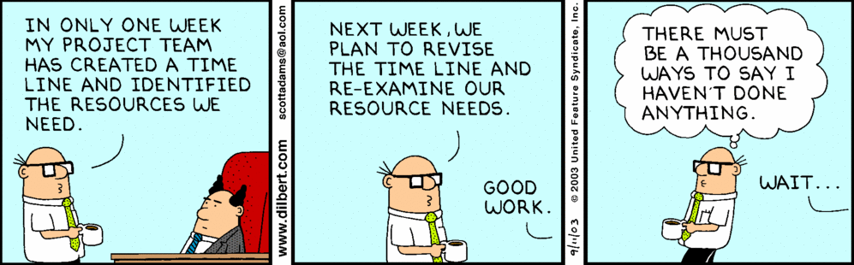
It’s all about controlling resources ☺

Slide 41

The “P’s” of a Software Project
People
Process
Product
Project
Phillips’ “3 P’s”
The actual event!
Notes:
People — the most important element of a successful project (in software projects, success is spelled “TEAM”)
Product — the software to be built (life cycle products from requirement to code to operational application)
Process — the set of framework activities and software engineering tasks to get the job done
Project — all work required to make the product a reality (execution of the plan)
Q3: What are the four “P’s” of a software project? [people, product, process, and project]

Slide 42

Ever-Important Question - SO WHAT?
Software Projects are
about RISK
(in retrospect!)
  If – then – else !
  Technical AND financial risks
Over 95% of all project failures
can be avoided by commonly known, but NOT so commonly practiced Software Project Management Principles and Practices
Sharing knowledge of the Business Case – a good start!

Slide 43
Coming up – Agile / Non-agile views
Intro to how each tackles the People – Process – Product sides of Projects.
How each avoids issues like you cited in your team exercise.
And how the Project Management complements your technical work, using each approach.
For starters – both approaches give credence to what’s on the next two slides →

Slide 44
Link to the technical view - SW Architecture Guides Planning
Architecture establishes the coordination mechanisms among the range of components and those who develop them
Blueprint (components and interfaces) informs the project plan:
  Team structure
  Documentation organization
  Work breakdown structure
  Scheduling, planning, budgeting
  Unit testing, integration
Why the project manager and architect / systems engineer need to work together!

Slide 45
Shared goal is to deliver –
System Quality Attributes
Performance
Availability
Usability
Security
Maintainability
Portability
Reusability
Testability
End
User’s
view
Developer’s
view
Time To Market
Cost and Benefits
Projected life time
Targeted Market
Integration with Legacy System
Roll back Schedule
Business
Community
view
ISO/IEC 9126-2001 Information Technology – Software Product Quality
Notes:
We will return to this when we’ll speak about Evaluating Architectures (ATAM, LAAAM)

